Slide 1
Qualcomm Reporting
Liu Yitong, Liu Hao, Shen Yun, Lin Qi, Li Yuchen
liuyitong@bupt.edu.cn
WT&T Lab @ BUPT

Slide 2
Outline
Study on QoE of DASH
- Propose QoE evaluation model based on Primacy and Recency
Effects
- Research QoE enhancement of DASH
- Identify QoE influence factors via two-way ANOVA analysis
Validation on DASH Service QoE Model
- Compare BUPT Model with UCSD Model
- Test 107 video samples and 64 particapants
- Propose QoE Model in 2 ways: non-linear regression and machine
learning
Research on Rate Adaptation Algorithms for DASH
- Propose a QoE based bit-rate adaptation algorithm
- Propose a bandwidth estimate method for 2 typical scenario
- Research on the impact of bit-rate adaptation for multi-user scenario
Study on video coding
- Fast CU Splitting and Pruning Method Based on Online Learning for Intra Coding In HEVC

Slide 3
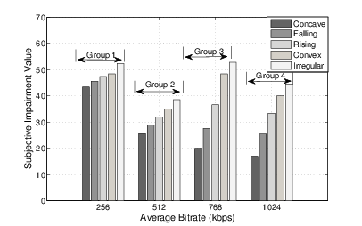
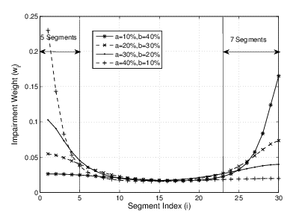
Quality of Experience Study on DASH
Subjective impairment tests under simulated environment
Influence factors:
Average bitrate
Bitrate fluctuation patterns:
Concave, Falling, Convex
Irregular: bitrate switches frequently with huge amplitude
Bitrate switching frequency
Impairment on bitrate fluctuation pattern
Impairment on bitrate switching

Slide 4
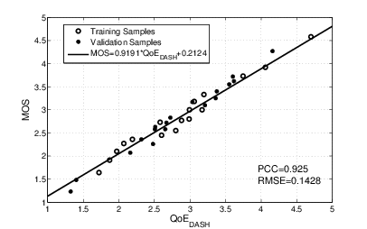
Quality of Experience Study on DASH
QoE evaluation functions:
Performance analysis
35 test videos from both simulated environment and real network traces
Two-fold cross validation
Pearson Correlation Coefficient = 0.92
RMSE = 0.14
Our QoE model can reflect user’s experience on DASH accurately

Slide 5
Test 3 Impairment Factors on DASH Service
R = f(I_{ID}, I_{ST}, I_{LV})
Model of UCSD
Test Videos
64 participants from BUPT are divided into 3 groups (Form 1, 2, 3 ).
Each tester watches about 45 test video clips in one hour.
Evaluation methodology: Single-Stimulus (SS).
Impairment due to Initial Delay
Impairment due to Level Variation
Impairment due to Stall
Video | Amount | Motion | Test factors
BunnyCartoon_Stall_1-11 | 11 | Medium | Stall
Movie_Case01-48 | 48 | Medium | All factors*
Sport_Case01-48 | 48 | High | All factors
All factors*: stall, initial delay, and level variation
Notes:
客观数据更新后，UCSD模型表现有所提升（见BUPT栏）
UCSD与BUPT主观测试得分契合度不高（PCC并不好，且MSE很高）

Slide 6
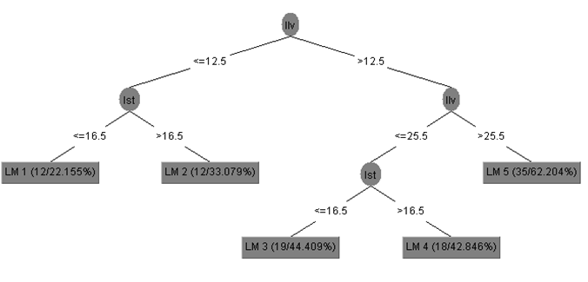
Propose QoE Model : non-linear regression and machine learning
Polynomial Model
PCC of Polynomial Model is higher than other basic elementary functions when m1=2, m2=m3=0.5.
Impairments by Stall and Level Variation hurt more than the Initial Delay Factors.
Three factors (initial delay, stall and level variation) are independent of one another to some extent.
Machine Learning Model
Notes:
客观数据更新后，UCSD模型表现有所提升（见BUPT栏）
UCSD与BUPT主观测试得分契合度不高（PCC并不好，且MSE很高）

Slide 7
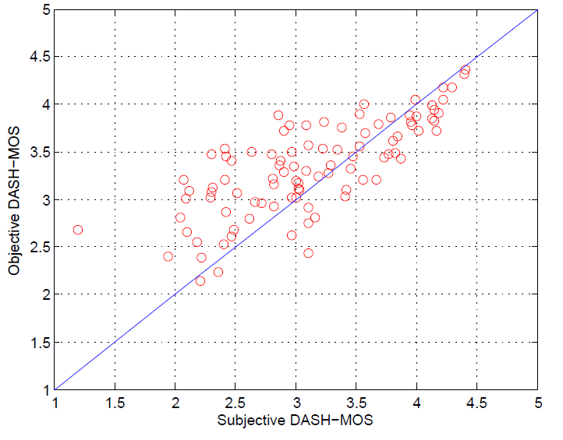
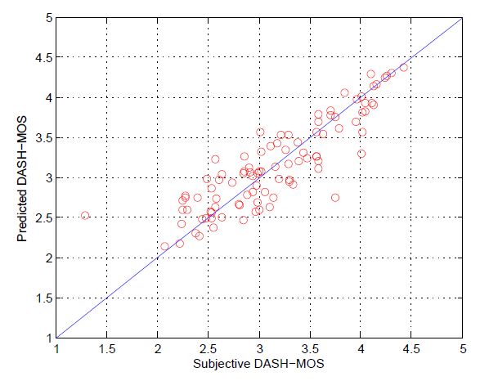
DASH Service Model Result
Polynomial Model
Machine Learning Model
Result of UCSD
PCC : 0.91
MSE : 0.082
Validation Result of UCSD Model PCC : 0.7811
MSE : 0.4267
Result of BUPT
PCC : 0.8719
RMSE : 0.310
ML Algorithm | Centesimal System Score (PCC) | MOS (PCC)
M5P model Tree | 0.84 | 0.84
Regression Tree | 0.85 | 0.84

Slide 8
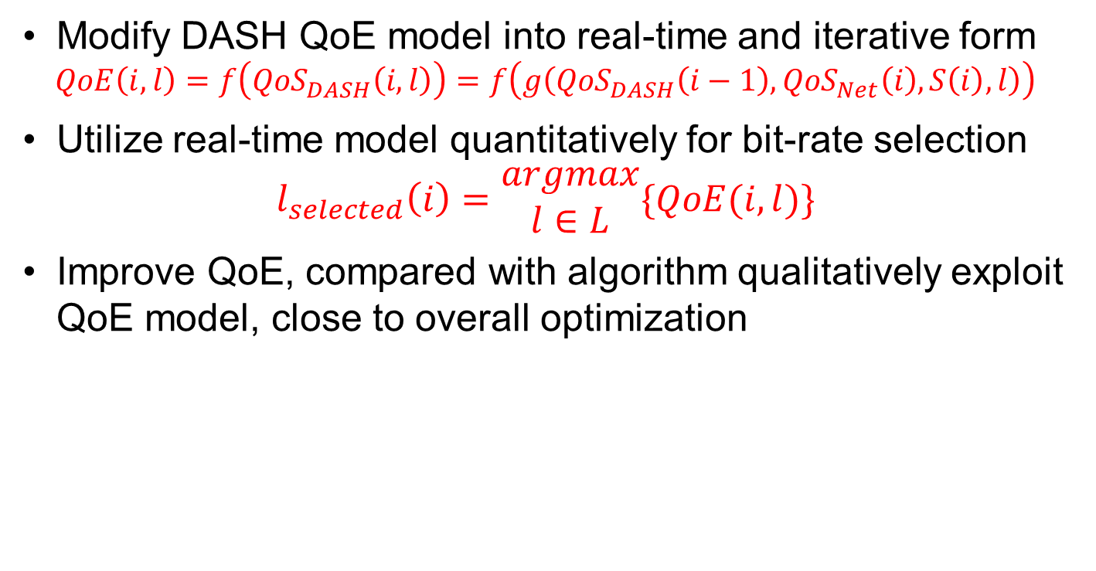
QoE Model Based Bit-Rate Adaptation
Modify DASH QoE model into real-time and iterative form
$$QoE\left(i,l\right)=f\left({QoS}_{DASH}\left(i,l\right)\right)=f\left(g\left({QoS}_{DASH}\left(i−1\right),{QoS}_{Net}\left(i\right),S\left(i\right),l\right)\right)$$
Utilize real-time model quantitatively for bit-rate selection
$$l_{selected}\left(i\right)=\begin{matrix}argmax \\ l∈L\end{matrix}\{QoE(i,l)\}$$
Improve QoE, compared with algorithm qualitatively exploit QoE model, close to overall optimization
Bandwidth Variation Scenario | QoS metric(Objective MOS)
 | Proposed Algorithm | Overall optimization | QoE-Enhanced^{[1]}
Fluctuation | 3.7419 | 3.7705 | 3.5773
Gradually drop | 3.8380 | 3.8405 | 3.3778
Dramatically drop | 3.9492 | 3.9506 | 3.7343

Slide 9
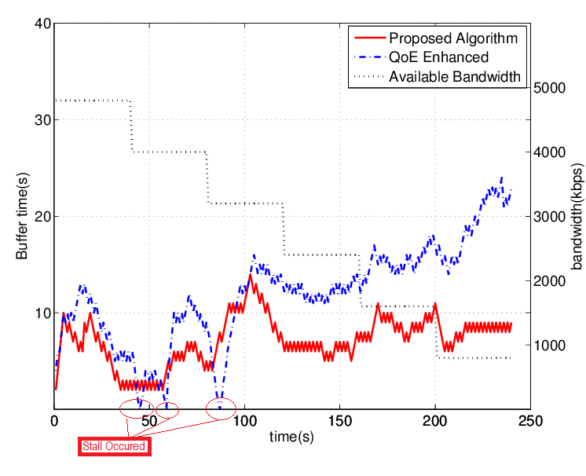

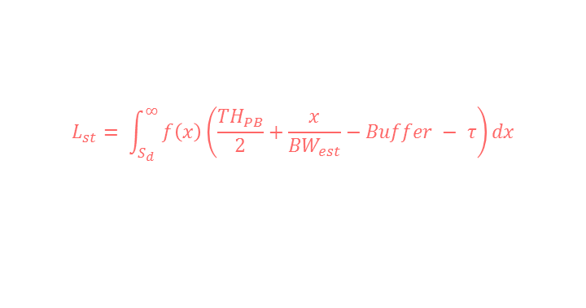
Stall Prediction
Exploit buffer accurately with precise stall prediction
Segment size obeys Gaussian Distribution
$S_{l}\sim N\left(μ,σ\right) with μ=b_{l }∗τ, σ=0.2μ$
Stall probability
$$P= \int_{s_{d}}^{∞}{f(x)}dx=1−Φ(\frac{S_{d}−μ}{σ})$$
$S_{d}= {BW}_{est}∗(Buffer+ τ)$
$$f\left(x\right)= \frac{1}{σ\sqrt{2π}}e^{− \frac{{(x−μ)}^{2}}{2σ^{2}}}$$
Stall duration
${TH}_{PB}$ : playback threshold
${BW}_{est}$: estimated bandwidth
$Buffer$ : current buffer of client
$τ$ : duration of a segment
$b_{l}$ : bit-rate of level $l$
$$L_{st}= \int_{S_{d}}^{∞}{f\left(x\right)\left(\frac{{TH}_{PB}}{2}+\frac{x}{{BW}_{est}}−Buffer − τ\right)dx}$$
Figure 1 . Buffer status in gradually drop scenario

Slide 10
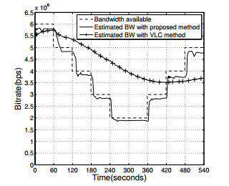
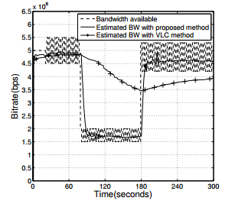


Bandwidth Estimation
Bandwidth estimate in 2 scenario
Long-term variation within a wide range – Response quickly
Short-term fluctuation within a narrow range – Keep stable
Figure 2 . Bandwidth estimation in scenario 1
Figure 3. Bandwidth estimation in scenario 2
Bandwidth pattern detect
$$CV\left(i\right)= \frac{S(i)}{\overline{T(i)}}$$
$S(i)$:standard variation of last n segment throughput
$\overline{T(i)}$:average of last n segment throughput
Bandwidth compute
$${BW}_{e}\left(i\right)= \sum_{j=i−n−1}^{i−1}{p\left(j−\left(i−n−1\right)\right)T(j)}$$
$p\left(k\right)= \left\{\begin{aligned}\frac{e^{k}}{\sum_{i=0}^{n−1}{e^{i}}} if CV\left(i\right)>0.1 \\ \frac{1}{n} others\end{aligned}\right.$

Slide 11
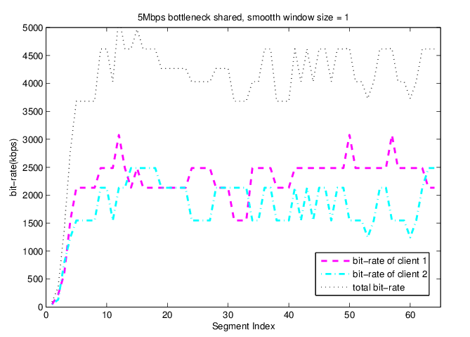
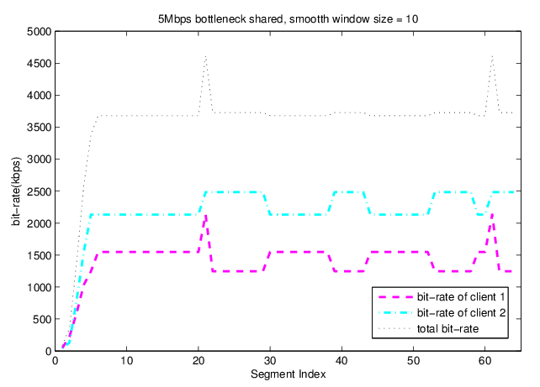
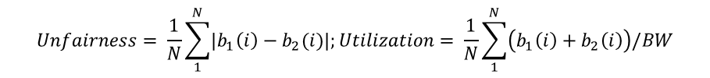
Multi-User Scenario
Simulate two-users condition, compared several bit-rate adaptation algorithm:
When bit-rate adaptation is smoother, less fairness achieved
When bit-rate adaptation is smoother, less efficient achieved
Figure 4 . Bit-rate of 2 users, smooth window size = 1
Figure 5 . Bit-rate of 2 users, smooth window size = 10
Smooth window size: the number of segments taken into estimating bandwidth, a larger value indicates a smoother algorithm
Figure 4. Less smooth, Unfairness = 545.9 Utilization = 0.819
Figure 5. More smooth, Unfairness = 784.3 Utilization = 0.712
$$Unfairness= \frac{1}{N}\sum_{1}^{N}{\left|b_{1}\left(i\right)−b_{2}(i)\right|;}Utilization= \frac{1}{N}\sum_{1}^{N}{\left(b_{1}\left(i\right)+b_{2}\left(i\right)\right)/BW}$$

Slide 12
Reducing HEVC Video Coding Complexity Method abstract
RMS cost is very big
RDO Cost in Depth0
compare
(RMS: Rough
Mode Search)
RDO Cost in Depth1
(RDO: Rate Distortion
Optimization)
RDO cost is very big
Figure. Partition of CU in HEVC with quadtree structure.
RMS is a pre-step of RDO, which screens out some suboptimal modes with low complexity
RDO/RMS cost is bigger, the distortion of prediction is more serious. The current CU is more likely to be split into four sub-CUs and vice versa.
Notes:
这里讲的是HEVC是如何迭代搜索一个CTU所有的划分可能性的。
在图像初始化划分好CTU后，编码器首先在最高层，也就是CU的大小是64x64的情况下进行搜索最佳模式，并进行编码。编码完成后，编码器会得出一个在此种CU划分下编码所需的代价值。这个代价值被称为RDO cost。RDO cost 是编码残差信息量和编码模式信息量的线性组合。残差信息量越大，RDO cost 越大。编码模式信息量越大，RDO cost也越大,两个都是正比例关系。
在得出最高层CU的RDO cost以后， 编码器将最高层64x64的CU划分成四个同等大小的32x32的CU。然后在每个子CU上独立的进行预测模式搜索和编码。最后，4个子CU会独立的得出自己的RDO cost。HEVC编码器会将这4个RDO cost求和然后拿求和后的结果和之前最高层的CU的RDO cost进行比较。谁的cost更小，说明谁的分割方式比另一种更好。如果结果说明分割为4个子CU效果更好，那么同样的步骤会在子CU上再来一次。直到达到CU的最大深度。
在HEVC的帧内编码中，在RDO之前程序会先计算RMS。RMS的目标是以较低的复杂度选出几个最有可能的预测模式，选出几个模式后，将这几个模式传给RDO再进行高复杂度的计算。可以理解为对RDO的一次初筛。RMS 同样需要对每种预测模式得出一个RMS cost，然后比较各个cost得到模式间好坏的比较。
我们会有一种感觉，那就是如果RMS 和RDO的cost都比较大的话，说明当前CU的预测模式和原始图像匹配的不是很好，是很有可能被分隔成更小的CU进行编码的。而反之，如果RMS 和RDO的cost都非常小的话，那么使用该大小的CU进行编码的效果已经很好，已经不再需要分割为更小的CU再进行计算了。对应在我们的程序流程上，我设计了两个编码的过程，来实现这个想法。
在图中，绿色的CU指的是该CU 的RMS cost已经很大。于是，在计算完RMS cost后，不再计算该CU的RDO cost，直接将改CU分割为四个子CU。这个过程体现在图中的CU1和他下面的4个子CU上。
而红的的CU指的是这个CU的RDO cost很小。于是我们不再计算改CU继续向下分割时的情况。以该CU直接最为最佳分割方式。
这两个处理安排都减少了编码器的运算量。加速了编码过程。

Slide 13
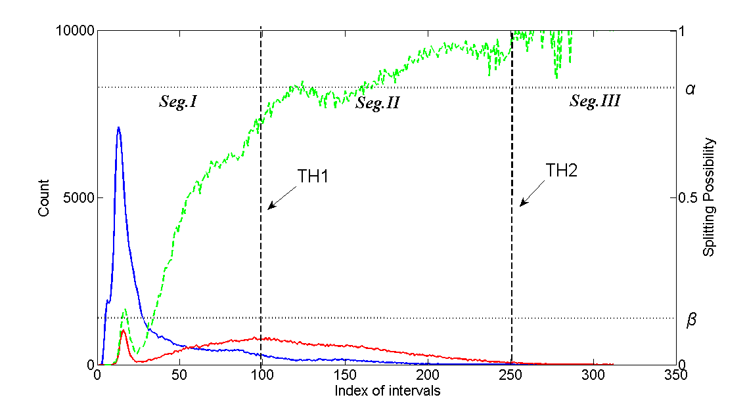


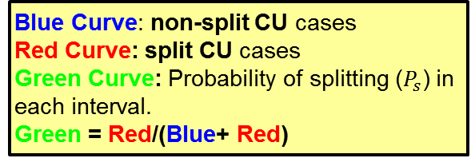
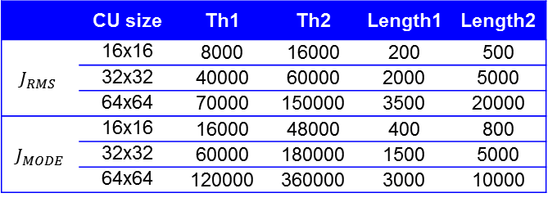
Histogram Statistics
Blue Curve: non-split CU cases
Red Curve: split CU cases
Green Curve: Probability of splitting ($P_{s}$) in each interval.
Green = Red/(Blue+ Red)
$$P_{s}$$
non-split CU
split CU
α: The threshold set on $P_{s}$ to perform ES
β: The threshold of EP
Figure 1*. Splitting Probability Statistics with isometric intervals
 | CU size | Th1 | Th2 | Length1 | Length2
$$J_{RMS}$$ | 16x16 | 8000 | 16000 | 200 | 500
 | 32x32 | 40000 | 60000 | 2000 | 5000
 | 64x64 | 70000 | 150000 | 3500 | 20000
$${ J}_{MODE}$$ | 16x16 | 16000 | 48000 | 400 | 800
 | 32x32 | 60000 | 180000 | 1500 | 5000
 | 64x64 | 120000 | 360000 | 3000 | 10000
Table 1. Values of Th1, Th2, Length1, Length2
Figure 2*. Splitting Probability Statistics with revised method
* The CU size of all samples in this figure is 16x16 and all data come from the first 30 frames of BQTerrace
Notes:
为了量化研究一个CU是否被继续划分为更小的CU这一问题 与 CU的RDO cost的关系，我们通过实验得出了以下的图。
在此图中，X轴指RDO cost的大小。Y轴指的是在某一cost下， 选择不分割当前CU以及分割的当前CU的样本数。其中蓝色线统计的是选择不分割的CU，红色线统计的选择分割的CU。绿色线是用红色线的值除以红色线加蓝色线的值。指的是在某一cost下，CU选择分割为4个子CU作为最优选择的概率。
绿色线的度量写在图的右边坐标轴上。可以看到，随着一个CU cost的增大，CU选择分割的概率就越大，这符合我们主观判断。
为了使用这个概率来加速CTU结构的选择。我们设置了两个阈值，一个是上阈值alpha，一个是下阈值beta。如果分割的概率高于上阈值alpha，那么就让编码器执行ES算法，算完RMS不必再算RDO。直接进行分割。如果COST小于下阈值beta，就让编码器执行EP算法，算完该CU的RDO后，不再算他的四个子CU。这样就节省了算法复杂度。
值得注意的是，在这幅图中，RDO 的大小被表示为区间序号。由于我们统计的是在区间上cost的样本数。在这幅图中，一个区间的长度被设置为50.也就是说，X轴为1时，实际代表的cost区间为0~50。以此类推。这样的统计方法有着一定的缺陷。
每一个区间上的样本数量相差很大。在COST值较大时，一个区间上在统计一帧图像后，得到的样本很少，造成分割概率统计的不准确。
为了解决这一缺陷，我设计了如下方法。在整个的X上，我设置了两个阈值，th1和th2。

Slide 14
Result
Class & Sequences |  | ∆Time | Ave. | BD-rate loss | Ave.
A | NebutaFestival | 54% | 46% | 0.21% | 0.82%
 | PeopleOnStreet | 29% |  | 0.66%
 | Traffic | 39% |  | 1.01%
 | SteamLocomotiveTrain | 63% |  | 1.41%
B | BasketballDrive | 43% | 41% | 0.81% | 1.35%
 | Cactus | 30% |  | 0.91%
 | BQTerrace | 30% |  | 0.77%
 | Kimono | 70% |  | 3.68%
 | ParkScene | 30% |  | 0.58%
C | BasketballDrill | 30% | 30% | 0.97% | 0.79%
 | BQMall | 31% |  | 1.19%
 | PartyScene | 29% |  | 0.50%
 | RaceHorsesC | 31% |  | 0.53%
D | BasketballPass | 35% | 28% | 1.22% | 0.75%
 | BlowingBubbles | 29% |  | 0.34%
 | BQSquare | 25% |  | 0.75%
 | RaceHorses | 23% |  | 0.69%
E | FourPeople | 41% | 49% | 1.37% | 1.52%
 | Johnny | 54% |  | 1.70%
 | KristenAndSara | 51% |  | 1.48%
 | Total |  | 38.8% |  | 1.05%
The performance is getting better with the increasing of the size of the sequences.
The performance will reduce when the sequence contains frequent scene switching. (Kimono)
Paper | Time Saving | BD-rate increasing
[1] | 20% | 0.74%
[2] | 23.52% | 1.3%
[3] | 21.1% | 1.74%
Proposed | 38.8% | 1.05%
[1] Wei Jiang et al, "Gradient based fast mode decision algorithm for intra prediction in HEVC" 2012,
[2] Shunqing Yan et al, "Group-based fast mode decision algorithm for intra prediction in HEVC” 2012,
[3] Liquan Shen et al, "Fast CU size decision and mode decision algorithm for HEVC intra coding," 2013.

Slide 15
Thank you!

